Slide 1

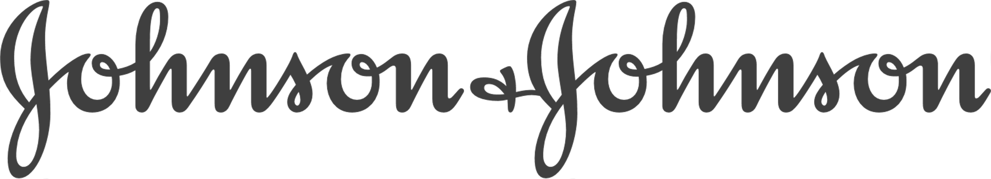



Enabling better managers and performance at leading organizations
What we can expect if we buy Textio Feedback

Slide 2
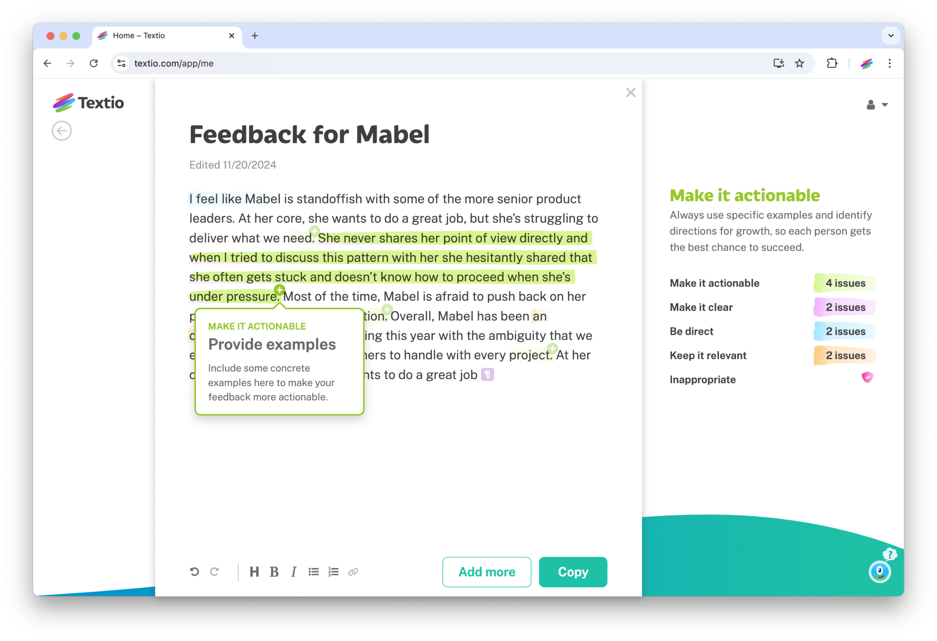

Textio would be a new way for us to help our managers to write and give better feedback
What we could do, but can’t today:
Help every manager give clear and actionable feedback every time
Scale high-quality feedback to every employee immediately
Prevent bias from impacting our performance and compensation work

Slide 3
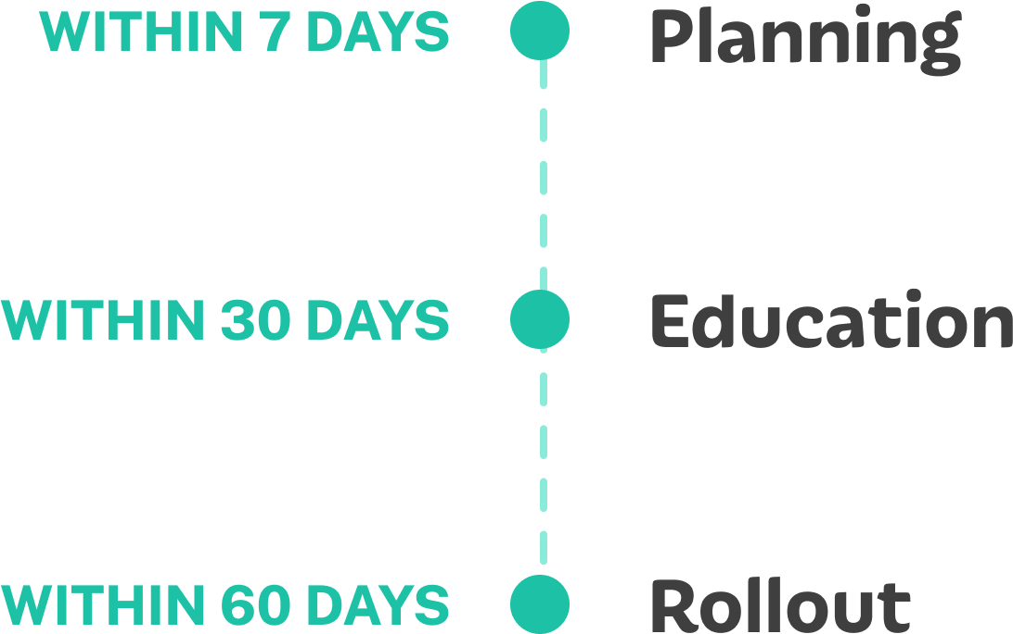
Anticipated timeline
What’s involved:
Textio customers are typically onboarded and giving feedback in 2 months.
Developing an implementation plan
Education and enablement for users
Setting up SSO and HRIS APIs
Rolling out Textio to everyone

Slide 4




The impact we could have
If we could scale better feedback quality with way less work involved
We would ensure our managers are giving every employee the coaching they need to grow
This means we’d spend less time on manager enablement and auditing performance conversations
While improving employee development, engagement, and retention

Slide 5

Additional return on investment
Improved employee performance and engagement
Velera improved feedback quality by 67%, leading to stronger team performance and reduced attrition
Increased efficiency through time saved
Velera cut feedback writing time by 50% so managers could focus on coaching
Foster inclusion and belonging
Upwork eliminated harmful language in feedback, improving employee trust
Learn more and read case studies

Slide 6
Analysis of 25,000 performance reviews from 250 enterprise orgs
52% of managers give employees
feedback on their personality
rather than their behavior
30% of managers
don’t provide enough suggestions
for how their employees can grow
52%
30%
15% of managers give
employees feedback with
harmful or offensive language
39% of managers
don’t use clear examples
to illustrate their feedback
15%
39%
Learn more and get the full report

